Slide 1
Machine Learning in Medical Diagnostics
Elvira Mingazova, Thuy Nguyen and Anh Duong Vo
2019-10-02

Slide 2
Outline
Motivation and goals
Prediction of Diabetes
Dataset and Preprocessing
Methods
Model
Results
Detecting cells infected with Malaria
Dataset
Methods
Preprocessing
Model
Results
Conclusion

Slide 3
Motivation and goals

Slide 4
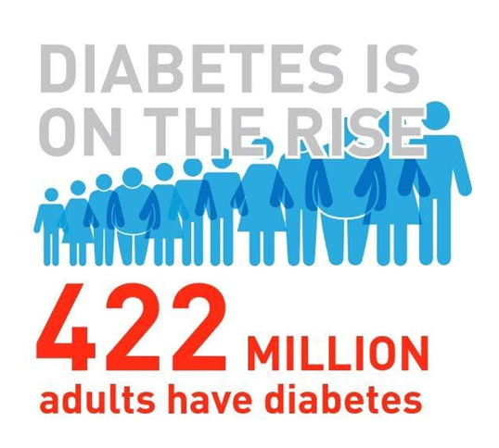
Motivation and goals
Prediction of Diabetes
Classification based on demographic, questionnaire data and laboratory examinations
Which lifestyle choices cause diabetes?

Slide 5
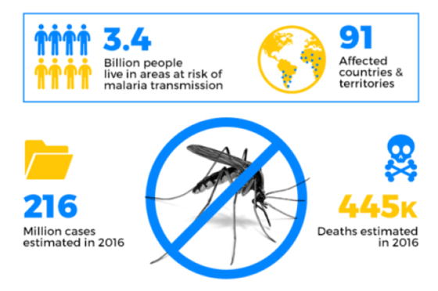
Motivation and goals
Prediction of Diabetes
Classification based on demographic, questionnaire data and laboratory examinations
Which lifestyle choices cause diabetes?
Detection of Malaria
Classification of images of blood smears
Can machine learning algorithms replace traditional methods for malaria detection?

Slide 6

Prediction of Diabetes | Dataset and methods
Before preprocessing:
~1700 attributes
~9000 participants
After preprocessing:
11 attributes
1579 entries
ML algorithms used:
Random forest
Support Vector Machines
Multilayer Perceptron

Slide 7
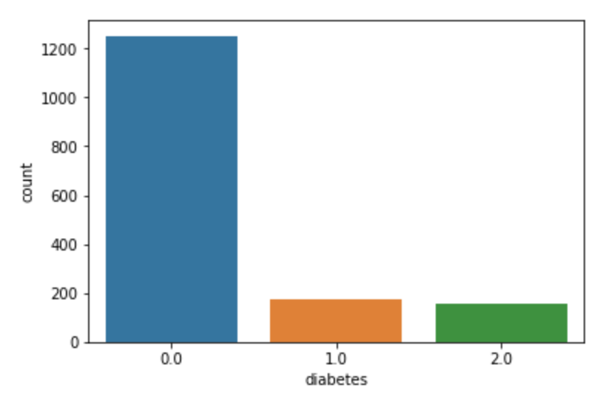
Prediction of Diabetes | 3 classes case
 | No diabetes - 0 | Prediabetes or at risk - 1 | Diabetes - 2
Glycohemoglobin | < 6.0 % | 6.0 - 6.5 % | > 6.5 %

Slide 8
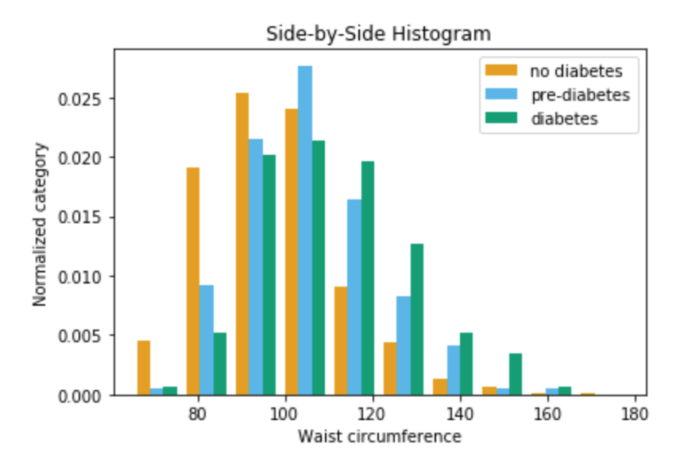
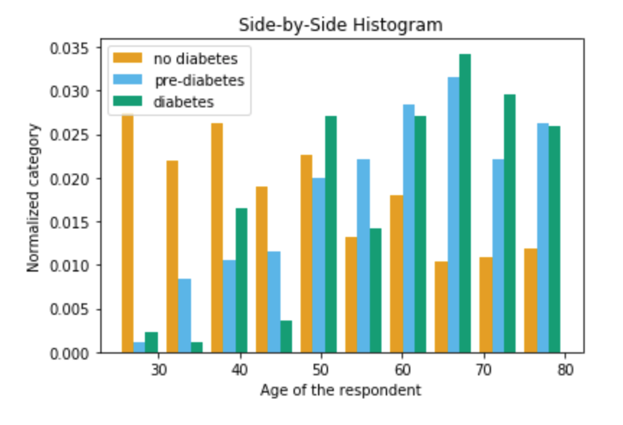
Prediction of Diabetes | 3 classes case
Feature investigation

Slide 9
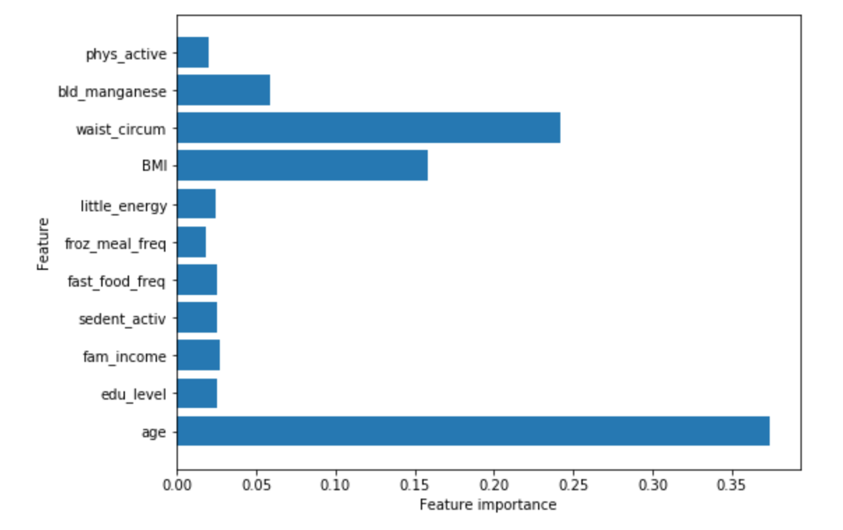
Prediction of Diabetes | Feature importance

Slide 10
Prediction of Diabetes | 3 classes case results
Confusion matrix
Model | Accuracy
RF | 0.791
SVM | 0.79
MLP | 0.794
Predicted True | 0 | 1 | 2
0 | 250 | 0 | 0
1 | 35 | 0 | 0
2 | 31 | 0 | 0
Good accuracy but a bad classification!

Slide 11
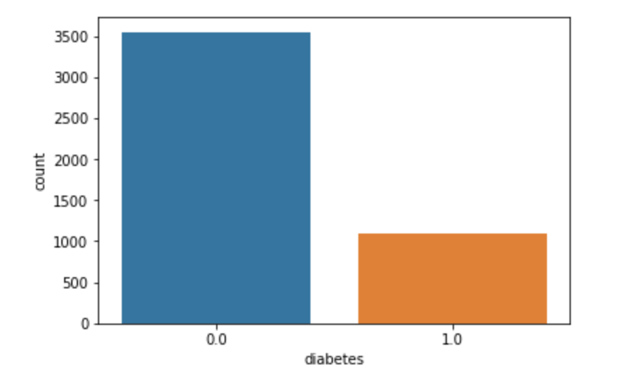
Prediction of Diabetes | 2 classes case
 | No diabetes - 0 | Prediabetes or diabetes - 1
Glycohemoglobin | < 6.0 % | > 6.0 %
4 features: BMI, Waist circumference, Age, Frozen meal frequency
4644 entries
Model | Accuracy
RF | 0.784
SVM | 0.77
MLP | 0.782

Slide 12
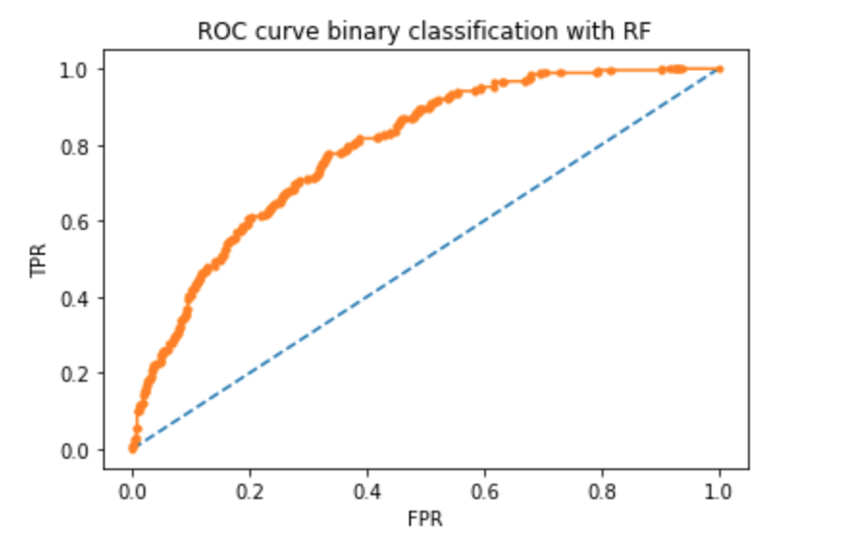
Prediction of Diabetes | Results
Confusion matrix
3 classes case
Confusion matrix
2 classes case
Predicted True | 0 | 1
0 | 869 | 19
1 | 232 | 41
Predicted True | 0 | 1 | 2
0 | 250 | 0 | 0
1 | 35 | 0 | 0
2 | 31 | 0 | 0
AUC = 0.791
Notes:
Don’t forget to mention the accuracy and talk about why you think you got these results

Slide 13
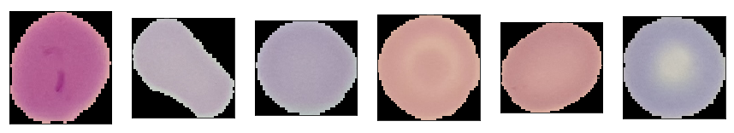
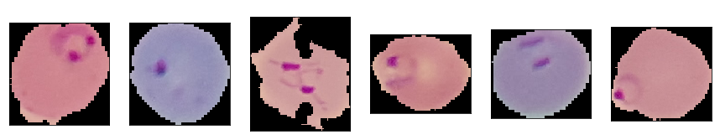
Detecting cells infected with Malaria | Dataset
Provided by Lister Hill National Center for Biomedical Communications
13777 images of healthy cells
133x133 pixels in average
13777 images of infected cells

Slide 14
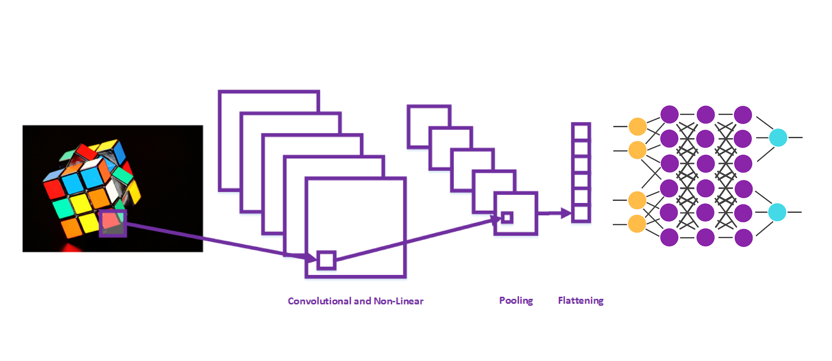


Detecting cells infected with Malaria | Methods
Convolutional Neural Network
Convolutional Neural Network
Convolution Pooling FC

Slide 15
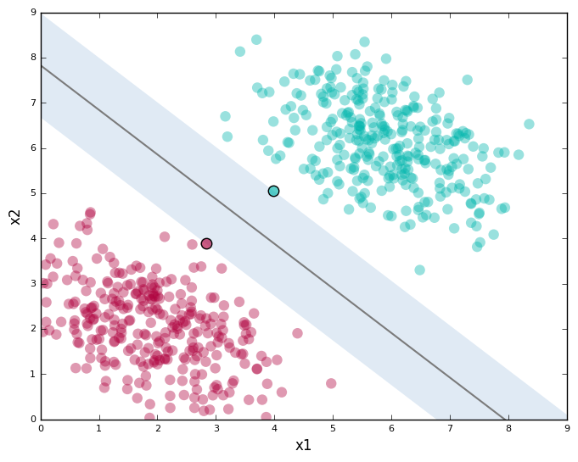
Detecting cells infected with Malaria | Methods
Convolutional Neural Network
Convolutional Neural Network
Support Vector Machine
Convolution Pooling FC

Slide 16
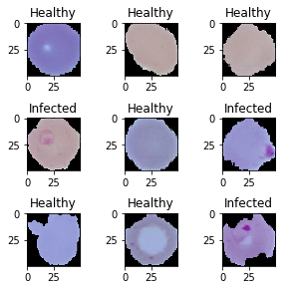
Detecting cells infected with Malaria | Preprocessing
Convolutional Neural Network
Support Vector Machine
Resized: 50x50 pixels

Slide 17
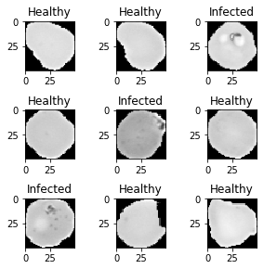
Detecting cells infected with Malaria | Preprocessing
Convolutional Neural Network
Support Vector Machine
Resized: 50x50 pixels
Resized: 50x50 pixels + greyscale

Slide 18
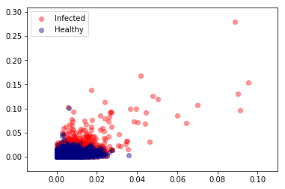
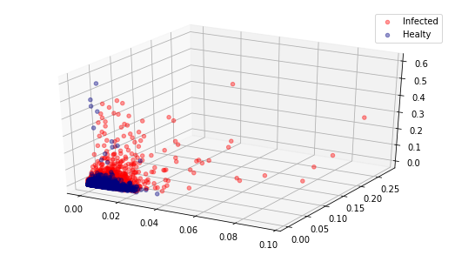
Detecting cells infected with Malaria | Preprocessing
Convolutional Neural Network
Support Vector Machine
Resized: 50x50 pixels
Normalized color histogram data

Slide 19
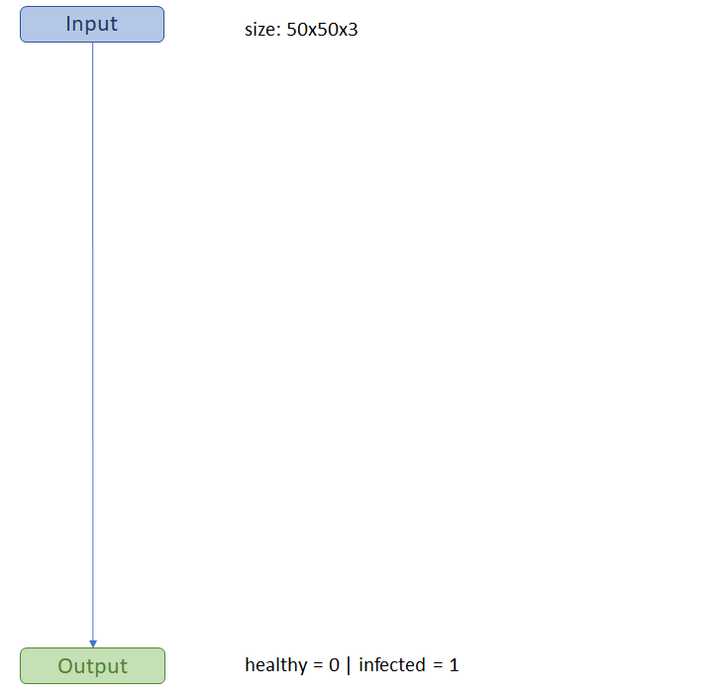
Detecting cells infected with Malaria | Model
Convolutional Neural Network
Support Vector Machine

Slide 20
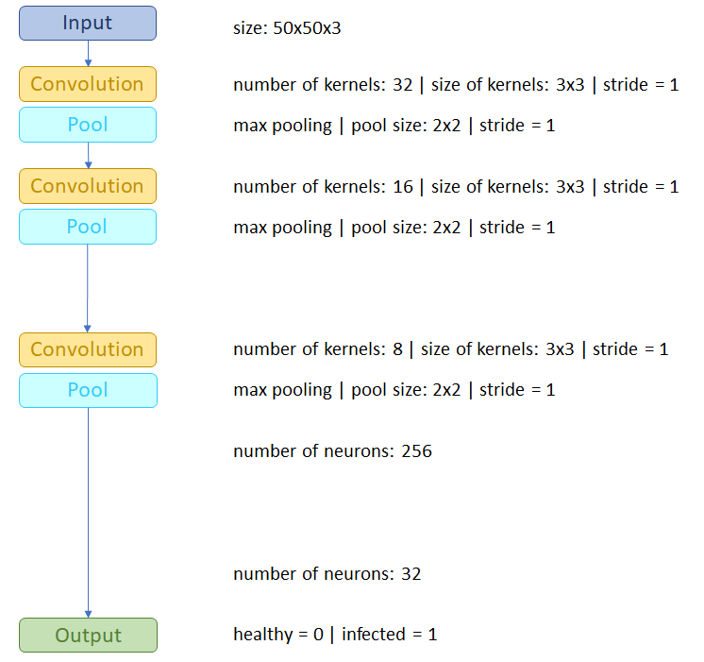
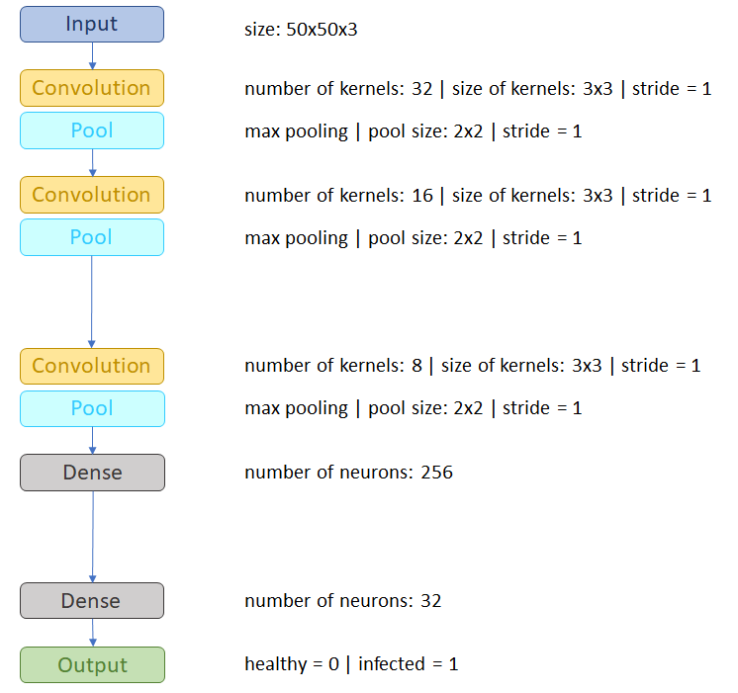
Detecting cells infected with Malaria | Model
Convolutional Neural Network
Support Vector Machine

Slide 21
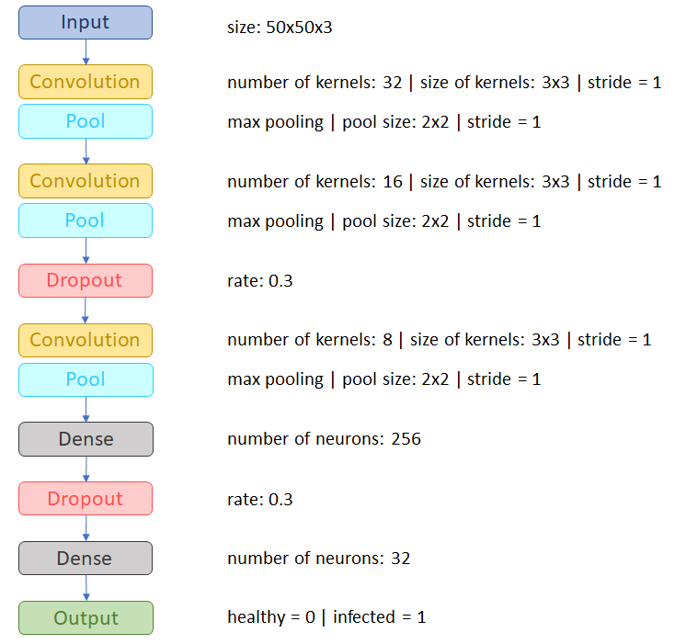
Detecting cells infected with Malaria | Model
Convolutional Neural Network
Support Vector Machine

Slide 22
Detecting cells infected with Malaria | Model
Convolutional Neural Network
Support Vector Machine

Slide 23
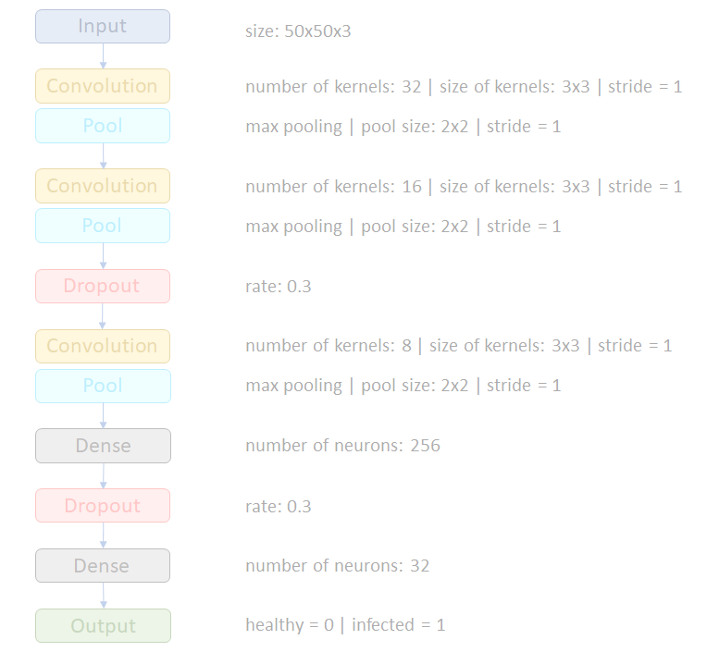
Detecting cells infected with Malaria | Model
Convolutional Neural Network
Support Vector Machine
Which kernel?

Slide 24
Detecting cells infected with Malaria | Model
Convolutional Neural Network
Support Vector Machine
Which kernel?

Slide 25
Detecting cells infected with Malaria | Model
Convolutional Neural Network
Support Vector Machine
→ Radial basis function Kernel

Slide 26
Detecting cells infected with Malaria | Model
Convolutional Neural Network
Support Vector Machine
→ Radial basis function Kernel
How many components?

Slide 27
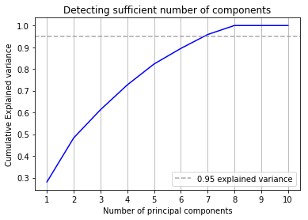
Detecting cells infected with Malaria | Model
Convolutional Neural Network
Support Vector Machine
→ Radial basis function Kernel
How many components?

Slide 28
Detecting cells infected with Malaria | Model
Convolutional Neural Network
Support Vector Machine
→ Radial basis function Kernel
How many components?

Slide 29
Detecting cells infected with Malaria | Model
Convolutional Neural Network
Support Vector Machine
→ Radial basis function Kernel
→ 7 principal components

Slide 30
Detecting cells infected with Malaria | Model
Convolutional Neural Network
Support Vector Machine
→ Radial basis function Kernel
→ 7 principal components
Values of 𝝲 and C?

Slide 31
Detecting cells infected with Malaria | Model
Convolutional Neural Network
Support Vector Machine
→ Radial basis function Kernel
→ 7 principal components
Values of 𝝲 and C?
Cross-Validation:
82.3% accuracy can be reached with 𝝲=1.0 and C=10.0

Slide 32
Detecting cells infected with Malaria | Model
Convolutional Neural Network
Support Vector Machine
→ Radial basis function Kernel
→ 7 principal components
→ 𝝲 = 1.0
→ C = 10.0

Slide 33
Detecting cells infected with Malaria | Results
Convolutional Neural Network
Support Vector Machine

Slide 34
Detecting cells infected with Malaria | Results
Convolutional Neural Network
Support Vector Machine
→ test accuracy: 0.94
→ test accuracy: 0.82

Slide 35
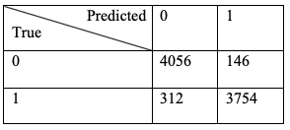
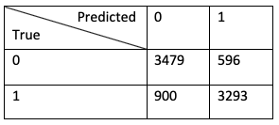
Detecting cells infected with Malaria | Results
Convolutional Neural Network
Support Vector Machine
→ test accuracy: 0.94
→ test accuracy: 0.82

Slide 36
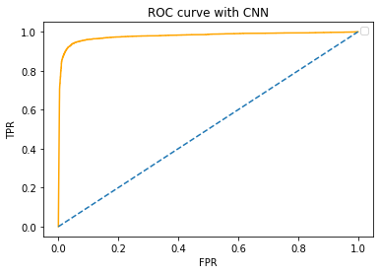
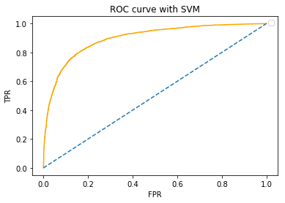
Detecting cells infected with Malaria | Results
Convolutional Neural Network
Support Vector Machine
→ test accuracy: 0.82
→ test accuracy: 0.94
→ AUC: 0.98
→ test accuracy: 0.82
→ AUC: 0.90

Slide 37
Conclusion
Diabetes part
Accuracy of almost 80 percent → further experimentation with dataset for better feature selection
Still: Conclusion that diabetes often results from a certain lifestyle
Malaria part
SVM accuracy of little over 80 percent and AUC of 90 percent → Model is not the best choice for this problem, but still useful and informative
CNN accuracy of 94 percent and AUC of 98 percent → good alternative to traditional medical diagnoses

Slide 38
Thank you for your attention!

Slide 39
References

